Slide 1
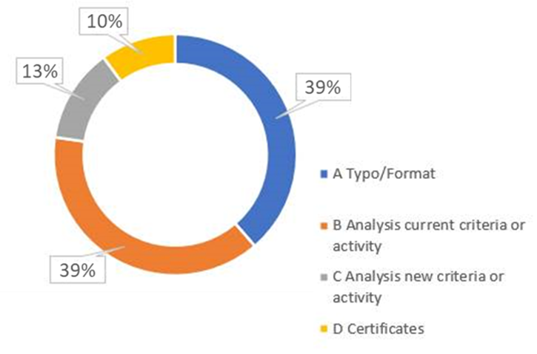
1
SFICS v2
The Sustainable Finance & Investment Classification System lays down the criteria for categorizing sustainable financial and investment products and services, and specifically how the Group defines Green, Social, Sustainability and Sustainable Finance. As part of its governance, it is reviewed on an annual basis, and we are presenting v2 of this document.
Feedback received over SFICS v1
Main updates included in SFICS v2
269 feedback points gathered, with 150+ on existing and new criteria/activities:
Included 2 new activities in SFICS:
1 in Water & Waste: “A.6.26 Use of recycled materials”
1 in Manufacturing: “A.8.35 Manufacture of electrical and electronic equipment contribution to circular economy”
New criteria and adjustments on previous criteria for existing activities (detail on all changes can be provided). For example:
EDGE Certificate Level 1 included as Santander Specific criteria accepted in some developing markets for real estate construction (A.3.1) and acquisition (A.3.7)
Integrated DNSH criteria aligned with EU Taxonomy for mortgages and auto portfolios, and approach for MSS for retail transaction and specific purpose transaction with CSRD clients / sponsor
Reviewed & updated the Socially Responsible Investment criteria (greater detail and clarity on criteria and regional differences)
SFICS v2
(Feb. 2025)

